Slide 1
SER Houston Portal
By Avner Khan, Jerry Huang, James Lu, Mutasim Chowdury, Gerald Joshua, Henry Vuong

Slide 2
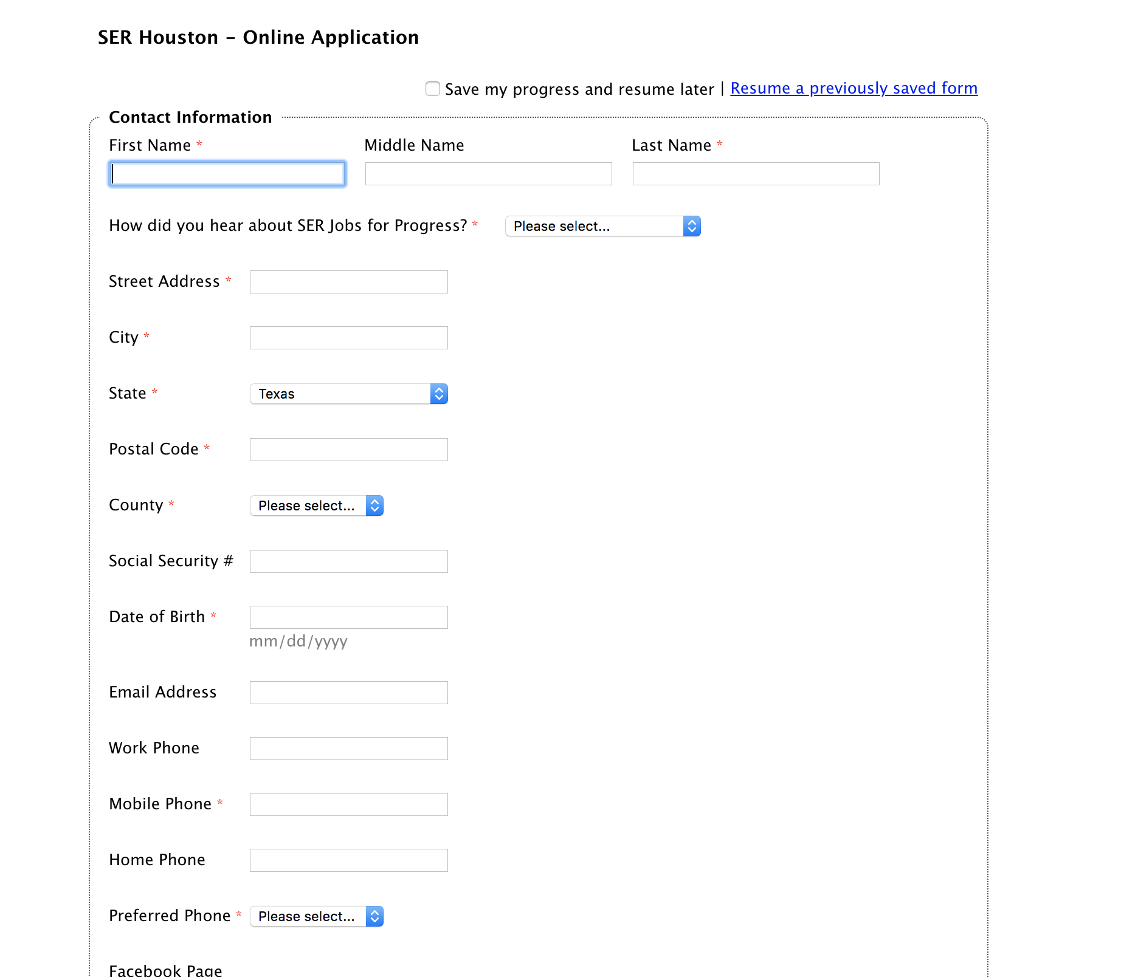
Problem
Barriers
Data capturing
Engagement
Uneventful experience
Digital illiteracy
Background

Slide 3
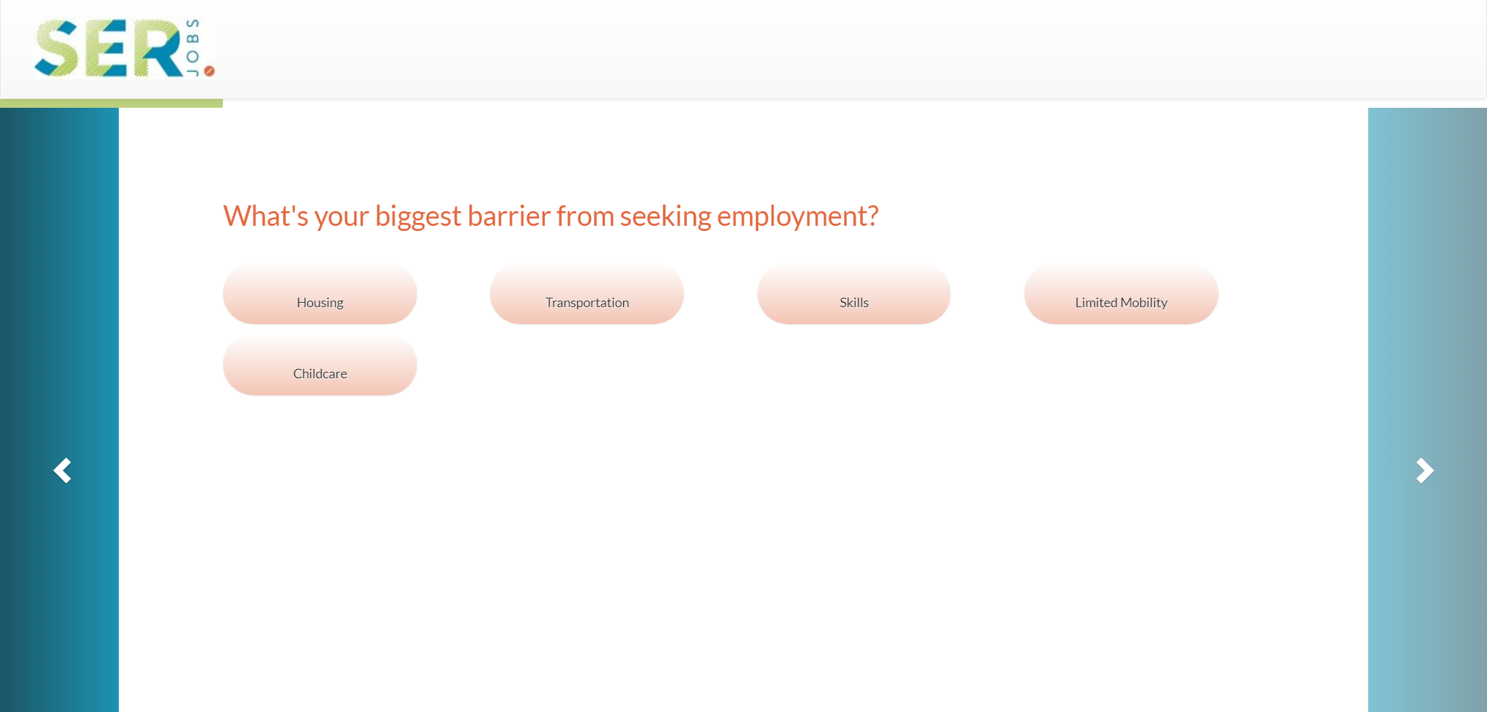
Solution
Clean UI
Constant Data Capture
Progress feedback
Tailored experience
Easier options
Encouragement and testimonials

Slide 4
Implementation
Full stack web app with front and backend functionality
Surface level:
Unique onboarding and application experience
Hidden:
Give user incentive to apply
Track their progress
Follow-Up Email

Slide 5
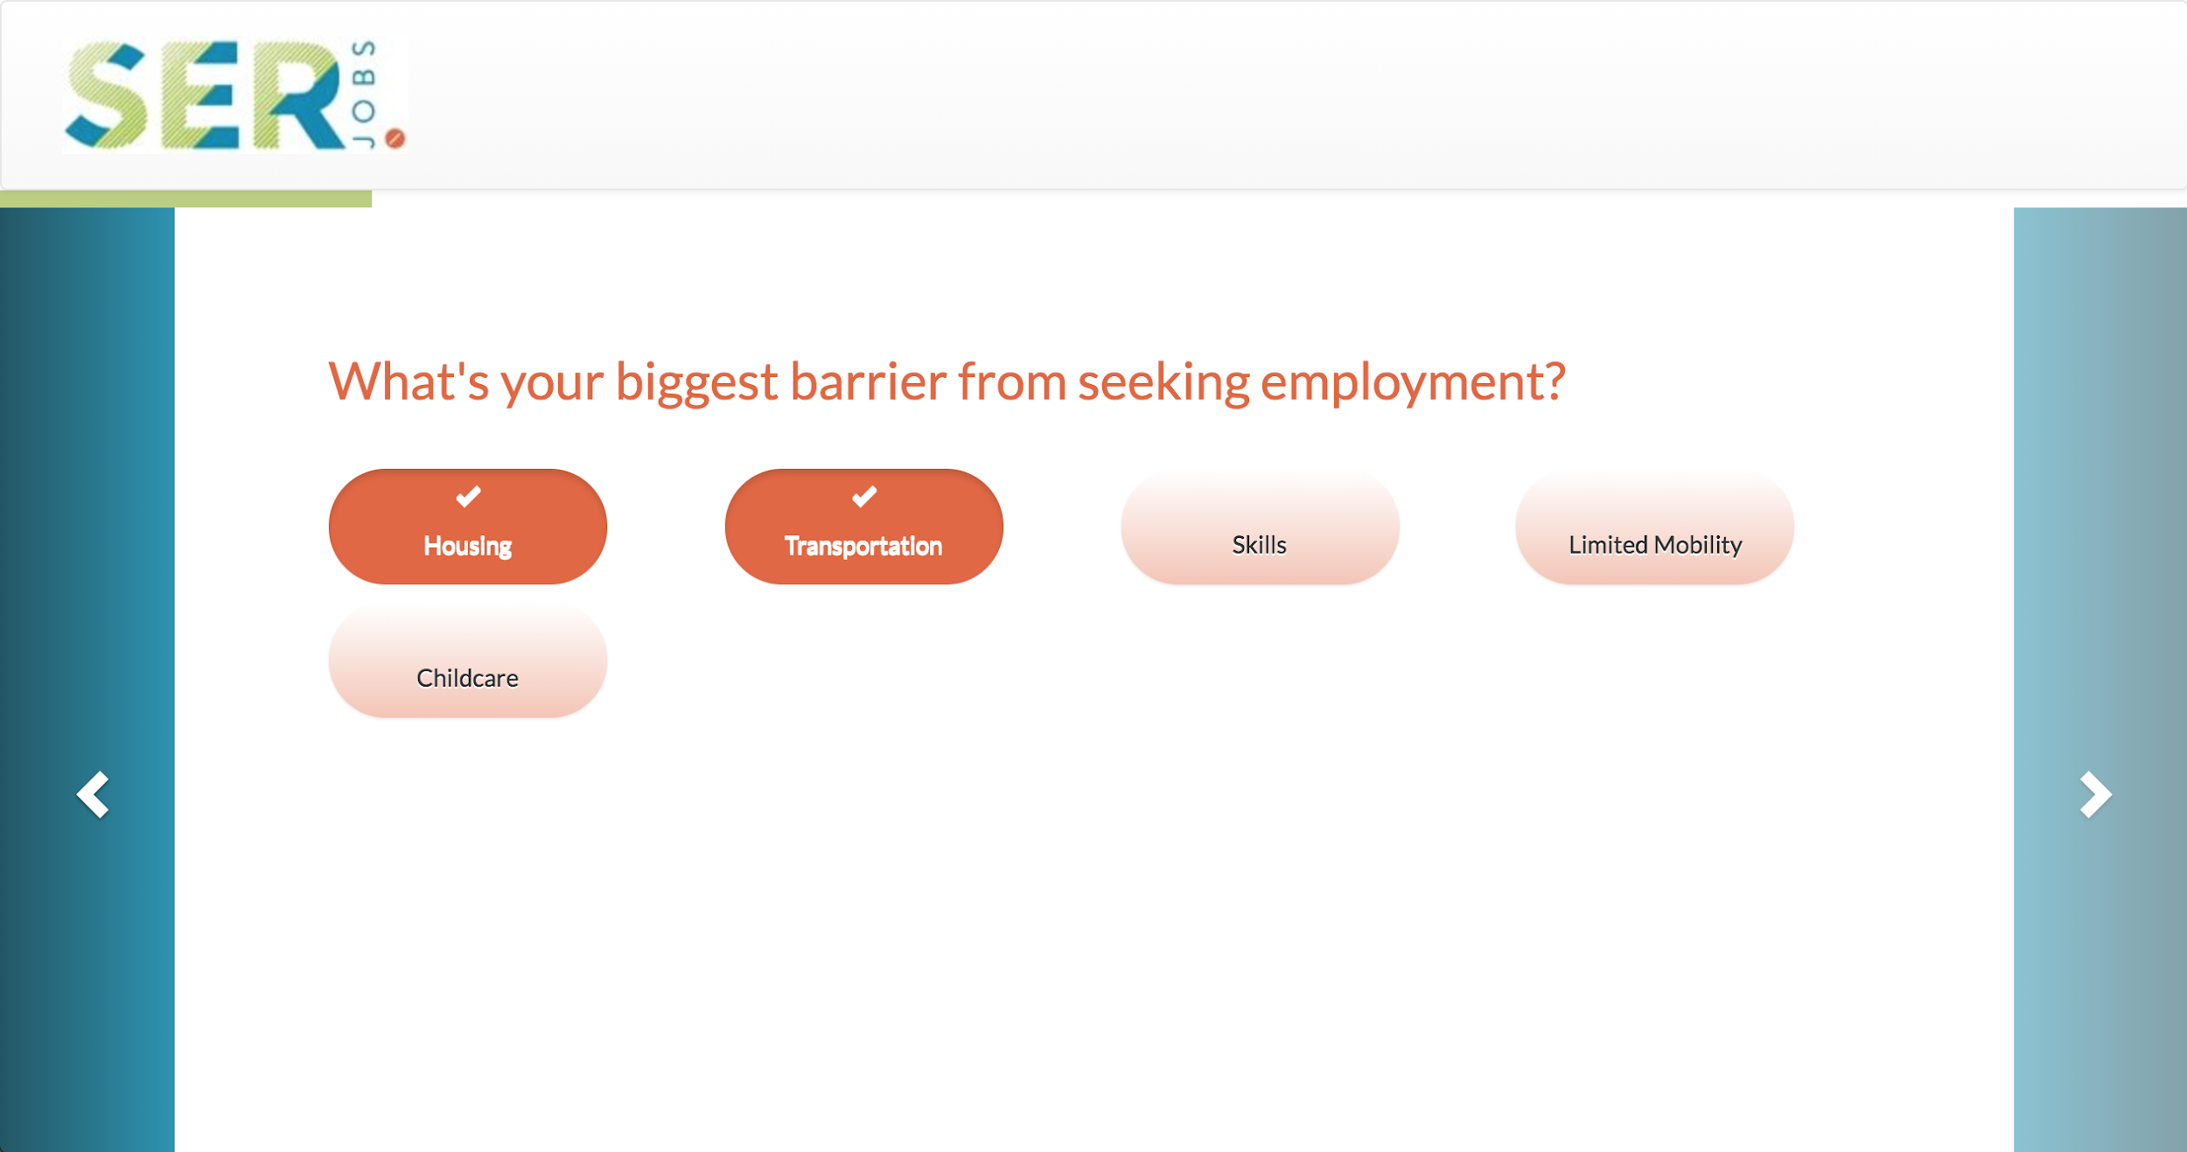
Frontend
Bootstrap templating with Carousel
Single view
Reusable slides
Progress indication
Post requests to Flask API

Slide 6
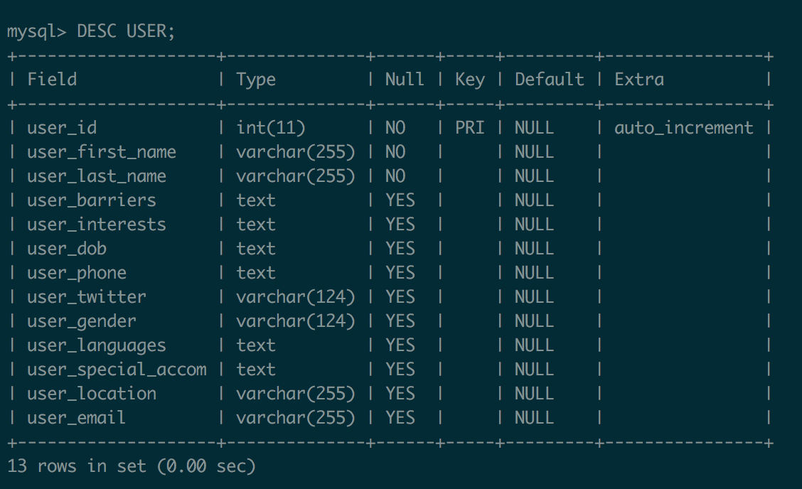
Backend - Flask/SQL
Flask with Python
API endpoint routes
Communication between frontend and MySQL database
MySQL:
User information (name, address, dob, email, job interests, etc…)
Saves half-completed applications

Slide 7
SERve Houston

